Slide 1


YESHWANTRAO CHAVAN COLLEGE OF ENGINEERING
Departmental Project Review Committee (DPRC) Seminar
ON
DEEP LEARNING BASED SHORT-TERM FORECASTING OF ORANGE AND COTTON CROP PRICES IN CONTEXT OF INDIAN MARKET
Presented By:
HUMANSHU D G | 147 | Section: B | College Guide:
SUSRUT PATOLE | 169 | Year: 2023-24 | Prof. (Dr.) Nileshsingh V. Thakur
NEHA THAKUR | 110
GEETIKA MAHANT | 102

Slide 2
CONTENTS
Introduction
Abstract
Aim
Objective
Literature Review
Patent Review
Research Gap
Project Utility
References

Slide 3
INTRODUCTION
India being majorly agrarian economy, farmers' livelihoods are greatly impacted by the pricing of crops like cotton and oranges.
India is one of the largest producers and exporters of cotton and oranges in the world.
These crops' prices are frequently unstable and change depending on a number of variables, including the weather, supply and demand, and governmental policy. Farmers and traders find it challenging to plan the timing of their product sales and purchases in light of these changes.
Accurate crop price forecasts can assist farmers, dealers, and policymakers in making educated decisions.
This issue is made worse by the absence of an accurate forecasting model for crop prices.
Deep learning algorithms can be used to estimate future prices by analyzing past price trends and other pertinent data.

Slide 4
ABSTRACT
In this project, the aim is to implement a Deep Learning-based model for the short-term forecasting of orange and cotton crop prices in the context of an Indian market. For this purpose, we will use the existing dataset available at Indian Government. We start by performing the exploratory data analysis(EDA) to take care of missing data and to identify the patterns. Later, we will split the data records to training, testing and validation set. We will use Deep Learning algorithms for this forecasting. Specifically, LSTM(Long short-term memory Networks) and Prophet will be used. We will use the results of statistical Machine Learning Algorithms and Deep Learning Algorithms. We are performing this time series analysis based on regional and seasonal aspects. We consider regional aspects by dividing dataset in tiers of urban and rural cities. We will compare the results and accuracy of deep learning models at different geographic levels, such as country, state, and particular cities.

Slide 5
AIM
To devise a Deep Learning based short-term forecasting mechanism of orange and cotton crop prices in context of Indian market.

Slide 6
OBJECTIVES
The objective of this project is to devise a deep learning based short-term forecasting model prices of orange and cotton crops within the context of Indian market. We aim:
For Data Collection & Planning for it along training data, testing data and validation data.
To devise a method to determine the appropriate number of data records for training the model.
To investigate different training from DL point of view.
To investigate existing Deep Learning Models like LSTM, Prophet,etc.
To investigate the scope of parameter tuning.
To develop Deep Learning based forecasting model.
To test and validate the developed model.
To compare Deep Learning models with Machine Learning based models like LR, SVR, etc.
To compare Deep Learning models with Statistical Learning based models like AR, ARIMA, SARIMA.

Slide 7
LITERATURE REVIEW
Ref.No | Work Carried Out | Methodology Used | Evaluation Parameters | Datasets Used | Claims By Author | Our Findings
1 | Hybrid EMD-TPE-LSTM Sugar Forecasting. | EMD-TPE-LSTM Hybrid Forecasting Model. | MAE, MAPE, RMSE metrics. | London Sugar Futures (2010-2020). | Outperforms existing models significantly | Limited hyperparameter optimization in forecasting.
2 | Crop yield prediction using DNN. | Deep neural network approach , SGD, Adam optimizer, L2 regularization. | RMSE, correlation coefficient. | Genotype, yield, environment data. | DNN outperforms Lasso, SNN, RT. | Black box model limitation.
3 | Crop yield prediction using DNN. | DNN with advanced optimization , Stacked deep neural networks. | RMSE, correlation coefficient. | 2018 Syngenta Crop Challenge. | DNN outperformed other methods. | Lack of explainable models.

Slide 8
LITERATURE REVIEW
Ref.No | Work Carried Out | Methodology Used | Evaluation Parameters | Datasets Used | Claims By Author | Our Findings
4 | Rice Yield Prediction | Deep Learning Regression , Convolutional Neural Networks, U-net, Seg Net, Refinet | Prediction Performance, Significant Analysis | Remote Sensing Images | Accurate Yield Estimation | Not Optimized
5 | CNN-LSTM for soybean yield. | GEE-based tensor workflow , CNN-LSTM. | RMSE, R2, Percent Error. | MODIS SR, MODIS LST, Daymet weather, USDA yield. | CNN-LSTM outperforms CNN, LSTM. | Insufficient features for prediction. Challenge in combining multisource data..
6 | Soybean yield prediction using CNN-LSTM. | Deep learning with remote sensing , CNN-LSTM model with GEE. | Prediction accuracy and model performance. | Crop growth, weather, MODIS. | Outperforms CNN and LSTM. | Limited studies on integrated models.

Slide 9
LITERATURE REVIEW
Ref.No | Work Carried Out | Methodology Used | Evaluation Parameters | Datasets Used | Claims By Author | Our Findings
7 | CropYield Prediction using ML and DL | Random Forest, SVM, Gradient Descent,LSTM | RMSE , MAE | official website of the Government. | ML model outperformed DL models | More DL models to be tested for better results
8 | Deep learning for crop yield prediction | LSTM, CNN,Deep Learning approach | MAPE, MAE, and MSE | Images and vegetation indices | CNN outperformed DNN and LSTM | Risk of overfitting due to lack of training dataset
9 | The Influence and Prediction of Industry Asset Price Fluctuation Based on the LSTM Model | Long Short Term Memory (LSTM) | Prediction Performance, DIF, DEA | The data was obtained through the sector asset data stations of the major websites | LSTM outperformed other methods. | Lack of explainable models.

Slide 10
LITERATURE REVIEW
Ref.No | Work Carried Out | Methodology Used | Evaluation Parameters | Datasets Used | Claims By Author | Our Findings
10 | Deep Learning for Price Movement Prediction Using CNN and LSTM | CNN and LSTM | PPMCC, correlation coefficient. | The data can be downloaded from Yahoo Finance (https://finance.yahoo.com/). | framework outperforms state-of-the-art models | Insufficient features for prediction.
11 | Improved Optimization Algorithm in LSTM to Predict Crop Yield | LSTM, CNN, RNN | MAE, RMSE | 2001 to 2020 from government websites of Andhra Pradesh. | IOFLSTM can outperform the CNN, RNN, and LSTM | Black box model limitation.

Slide 11
LITERATURE REVIEW
Ref.No | Work Carried Out | Methodology Used | Evaluation Parameters | Datasets Used | Claims By Author | Our Findings
12 | RNN with a dimension-reducing symbolic representation is applied for time series forecasting | RNN and LSTM | sMAPE, Euclidean distance, and dynamic time warping | HouseTwenty dataset in the UCR Time Series Classification archive | ABBA-LSTM mode l outperforms simpler statistical methods with faster training and forecasting times | visually better forecasts, ABBA-LSTM models offer faster training and forecasting times
13 | Comparing Prophet and Deep Learning to ARIMA in Forecasting Food Prices | ARIMA, Prophet and CNN | RMSE, MAPE and MAE | self sampled 260,000 food order records | ARIMA and LSTM similar while CNNs and LSTMs has best overall accuracy | Prophet fast but less accurate while LSTM and CNN requires more time for tuning

Slide 12
LITERATURE REVIEW
Ref.No | Work Carried Out | Methodology Used | Evaluation Parameters | Datasets Used | Claims By Author | Our Findings
14 | review of scientific publications (2012 to 2021) to evaluate the use of ML & DL for predictive quality in manufacturing processes | RNN, CNN, LSTM(s) and Seq2Seq | MAPE, MAE, and MSE | NEU-DET, Xuelang manufacturing AI challenge data, Kaggle | Potential of data-driven methods in quality assurance and inspection. | improvement required for data generation methods
15 | Prediction model for Gulf stock exchange market | SARIMA, Neural Prophet Model, and Fb Prophet model | MSE, RMSE, recall, MDAPE, accuracy, precision, etc. | Mulkia GULF Real Estate | Time series analysis useful in hidden causes of the trends | neural prophets effective in complex relationships, Fb prophet has more efficiency

Slide 13
LITERATURE REVIEW
Ref.No | Work Carried Out | Methodology Used | Evaluation Parameters | Datasets Used | Claims By Author | Our Findings
16 | Approach to sequence learning with minimal assumptions | DNN, LSTM and SMT, Feedforward NNLM | BLEU Score | WMT’14 dataset | LSTM outperforms SMT system | LSTM fails on long sentences, Scope in Seq2Seq problems
17 | Forecasting COVID-19 Pandemic | Prophet, ARIMA, LSTM-GRU, RNN and LR | R square and RMSE | John Hopkins University repository, WHO, ourworldindata.org, etc. | LSTM and GRU model outperforms all other models | hybrid model to generate more accurate findings

Slide 14
PATENT SEARCH
Patent Application No. | Title of Patent | Existing Solutions (Abstract of Patent)
CN103577581B | Agricultural product price trend forecasting method | The technique of agricultural product price trend forecasting described in the invention includes the following steps. Step 1: computer-acquired article relevant to agricultural commodity price and with a forecasting standpoint; Step 2: Duplicate elimination is completed on the collected articles; Extract and save the article's important element in step three.Step 4: The location of the agricultural product-related area mentioned in the article is found; Step 5: Quantify and preserve agricultural products according to the given predictability viewpoint after analyzing expert opinions using text mining technology; Step 6: Utilizing the model established so that agricultural product price is carried out-trend prediction, the trend prediction viewpoint delivering time, agricultural product affiliated area, agricultural product sort, and quantization according to article is carried out using microcomputer modeling.

Slide 15
PATENT SEARCH
Patent Application No. | Title of Patent | Existing Solutions (Abstract of Patent)
CN105205099B | A kind of agricultural product price analysis method | The steps included in the technique of agricultural product price analysis that the present invention relates to are as follows: Information about the types of agricultural products is gathered using one assembled classifier of pre-trained search engines; The default commodities trading website is crawled to obtain the geographic location information of the supplier for each category of agricultural commodity as well as the pricing data .It is divided based on the area where agricultural goods are cultivated, with each agricultural product kind carrying out agricultural production and obtaining information on the area where agricultural goods are cultivated for each kind.

Slide 16
PATENT SEARCH
Patent Application No. | Title of Patent | Existing Solutions (Abstract of Patent)
WO2018232845A1 | Smart agriculture management method and system | The present invention relates to a smart agriculture management system and method, the system comprising: monitoring soil nutrient data and moisture data; acquiring historical weather data and predicted weather data; acquiring historical price data; comparing the nutrient data with a nutrient content standard value and comparing the moisture data with a moisture content standard value; processing and analyzing the historical price data of the crop and the historical weather data. The system consists of a control center, a soil monitoring module, an information-gathering module for the weather, and an acquisition module for prices.

Slide 17
RESEARCH GAP
Limited hyperparameter optimization in forecasting.
Lack of explainable models.
Insufficient features for prediction.
Challenge in combining multisource data.
Limited studies on integrated models.
More DL models to be tested for better results.
Risk of overfitting due to smaller dataset size.
Lack of explainable models.
Insufficient features for precise prediction.

Slide 18
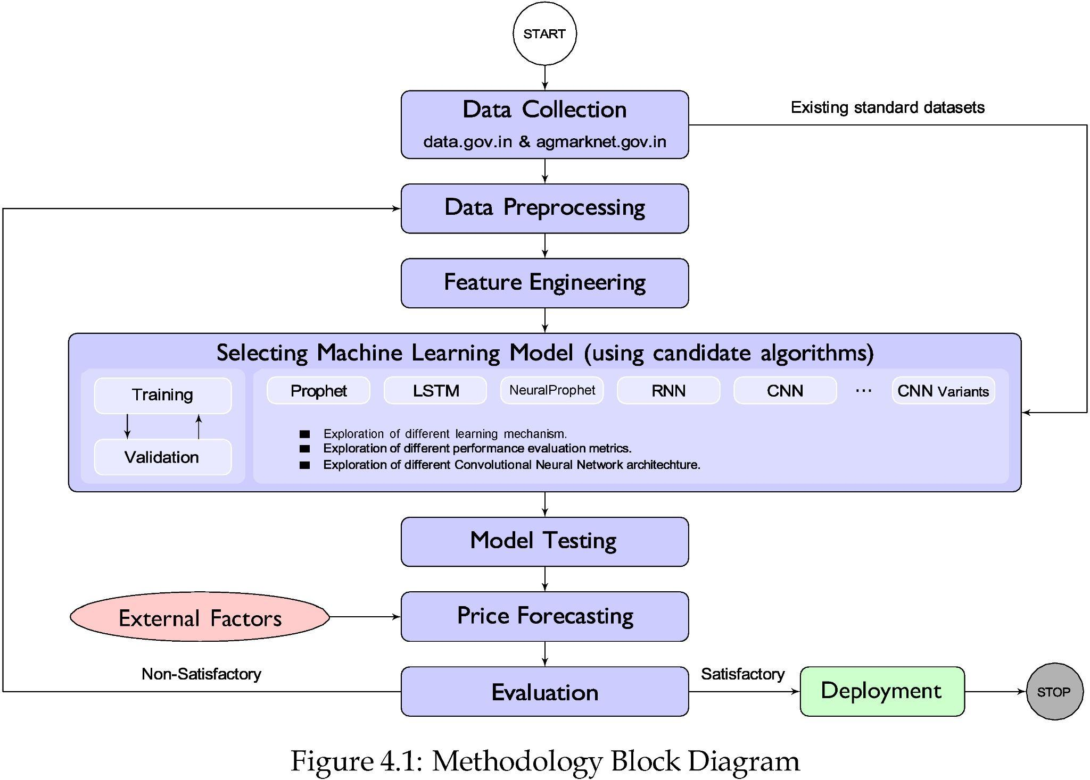

Slide 19
PROJECT UTILITY
Price Forecasting for Decision-Making
Risk Mitigation
Supply Chain Optimization
Resource Allocation
Model Comparison
Improving existing models

Slide 20
REFERENCES
[1] ”A Novel Hybrid Deep Learning Model for Sugar Price Forecasting Based on Time Series Decomposition” Jinlai Zhang, Yanmei Meng, Jin Wei, Jie Chen, and Johnny Qin
[2] “Short‑term stock market price trend prediction using a comprehensive deep learning system”
Jingyi Shen and M. Omair Shafiq
[3] “Crop Yield Prediction Using Deep Neural Networks”
Saeed Khaki, Lizhi Wang
[4] “Research on Rice Yield Prediction Model Based on Deep Learning” Xiao Han, Fangbiao Liu, Xiaoliang He, and Fenglou Ling
[5] “Crop yield prediction integrating genotype and weather variables using deep learning “,Johnathon Shook, Tryambak Gangopadhyay

Slide 21
REFERENCES
[6] “County-Level Soybean Yield Prediction Using Deep CNN-LSTM Model”
Jie Sun, Liping Di , Ziheng Sun , Yonglin Shen and Zulong Lai
[7] “Crop Yield Prediction using Machine Learning and Deep Learning Techniques” Kavita Jhajhariaa, Pratistha Mathura, Sanchit Jaina, Sukriti Nijhawana
[8] “Deep learning for crop yield prediction”Alexandros Oikonomidisa, Cagatay Catalb and Ayalew Kassahuna
[9] “The Influence and Prediction of Industry Asset Price Fluctuation Based on the LSTM Model and Investor Sentiment” Wenxiu Hu, Huan Liu , Xiaoqiang Ma,and Xiong Bai
[10]“Deep Learning for Price Movement Prediction Using Convolutional Neural Network and Long Short-Term Memory” Can Yang, Junjie Zhai , and Guihua Tao
[11] “Improved Optimization Algorithm in LSTM to Predict Crop Yield” Usharani Bhimavarapu, Gopi Battineni and Nalini Chintalapudi

Slide 22
REFERENCES
[12] "Time Series Forecasting Using LSTM Networks: A Symbolic Approach" Steven Elsworth and Stefan Güttel
[13] "Comparing Prophet and Deep Learning to ARIMA in Forecasting Wholesale Food Prices" Lorenzo Menculini et al.
[14] "Machine learning and deep learning based predictive quality in manufacturing: a systematic review" Hasan Tercan and Tobias Meisen
[15] "A Novel Deep-learning based Approach for Time Series Forecasting using SARIMA, Neural Prophet and Fb Prophet" Khulood Albeladi, Bassam Zafar, and Ahmed Mueen
[16] “Sequence to Sequence Learning with Neural Networks” Ilya Sutskever et al.
[17] “Forecasting COVID-19 Pandemic Using Prophet, ARIMA, and Hybrid Stacked LSTM-GRU Models in India” Sweeti Sah et al.

Slide 23
THANK
YOU

